Slide 1
WindTracker
Serverless Computing for IoT
Vincenzo Offertucci 052251546

Slide 2
Table of contents
01
02
03
04
Introduction
Tools
Architecture
Conclusions

Slide 3
01
Introduction

Slide 4
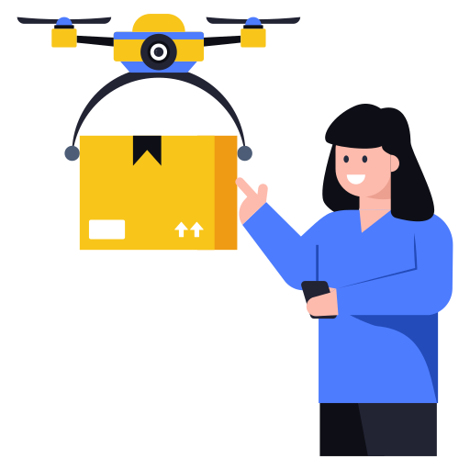
Introduction
One of the applications of drones (Unmanned Aerial Vehicles) is last-mile package delivery. In the last years the number of commercial drone delivery has started to grow, and the current activity involves more than just test flights.
Drones have to choose the best path for the delivery in order to reduce energy consumption and time to deliver. To do so, one of the factors to take in consideration is wind.
So, the purpose of WindTracker is to offer a way to efficiently get data about wind.

Slide 5

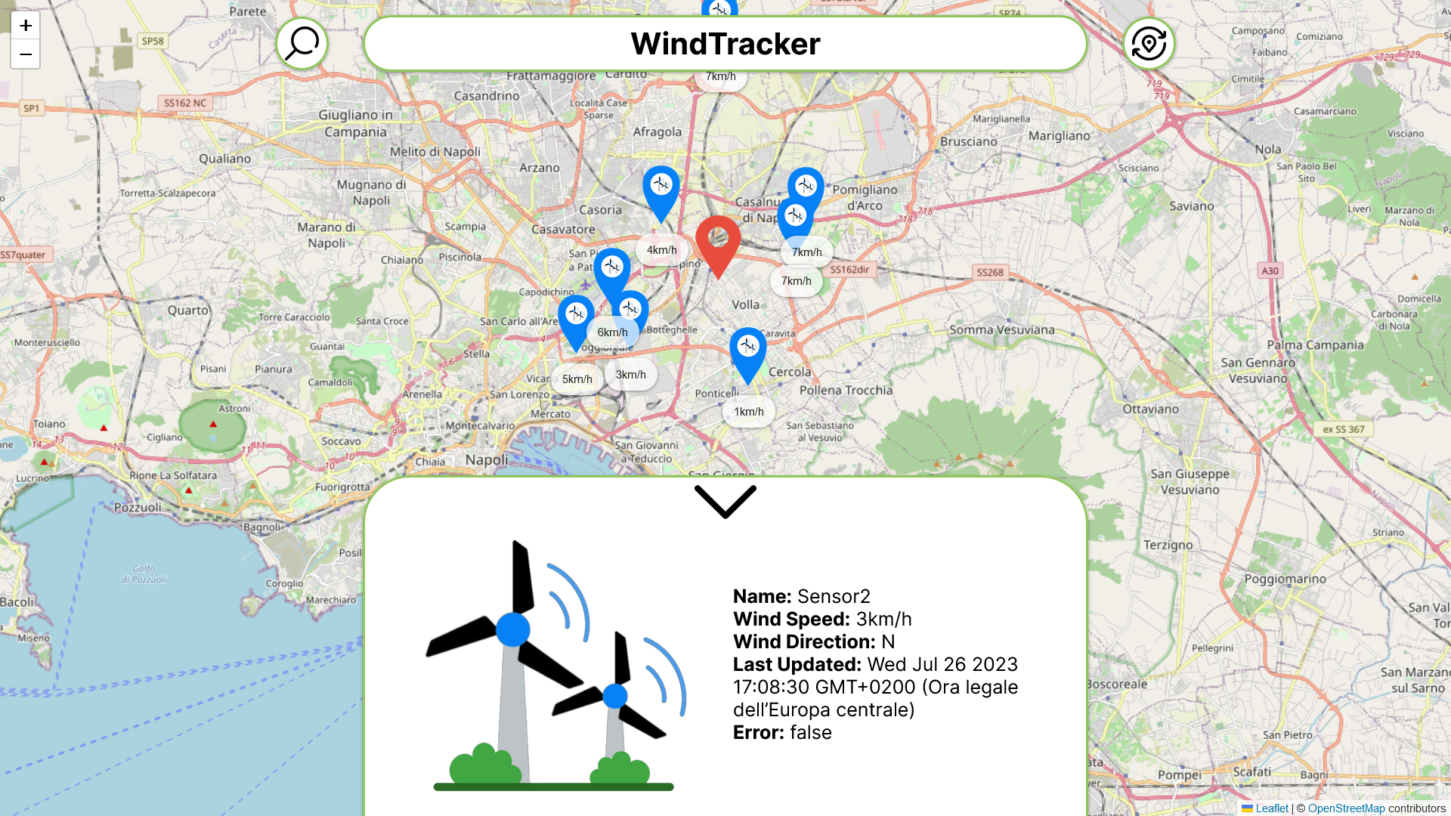
WindTracker
WindTracker offers a way for drones to get updated data about wind in real time.
It allows the user to:
Add wind sensors to the infrastructure
Handle errors that can occur to the sensors
Store data about wind to make predictions about wind direction and speed
Visualize live data about wind through a web application

Slide 6
02
Tools

Slide 7
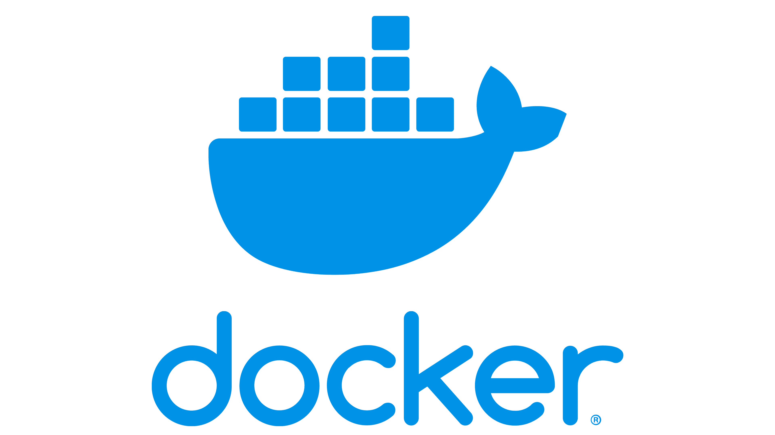
Docker
Docker is an open platform for developing, shipping, and running applications.
Docker provides the ability to package and run an application in a loosely isolated environment called a container.
Containers are lightweight and contain everything needed to run the application, so you do not need to rely on what is currently installed on the host.

Slide 8

LocalStack
LocalStack is a cloud service emulator that runs in a single container on your laptop or in your CI environment.
With LocalStack, you can run your AWS applications entirely on your local machine without connecting to a remote cloud provider.

Slide 9
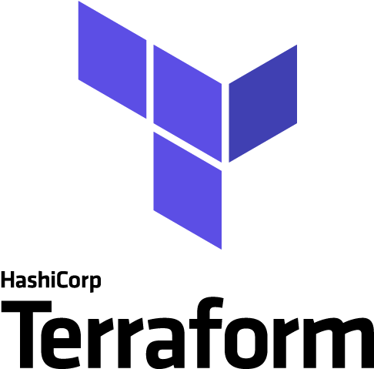
Terraform
Terraform is an open-source IaC (Infrastructure-as-Code) tool that enables you to safely and predictably provision and manage infrastructure in any cloud.
Users define and provide data center infrastructure using a declarative configuration language known as HashiCorp Configuration Language (HCL).

Slide 10
03
Architecture

Slide 11
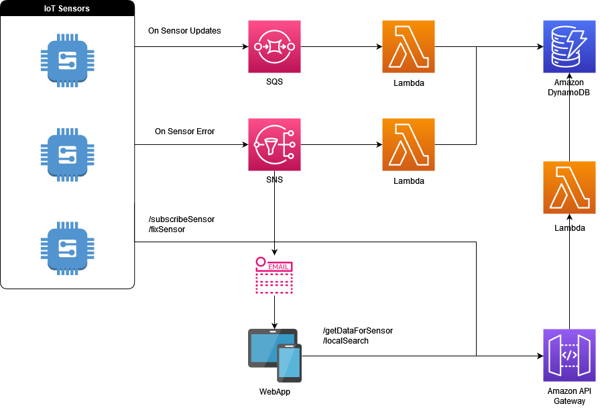
Architecture

Slide 12

Amazon DynamoDB
Amazon DynamoDB is a fully managed NoSQL database service that provides fast and predictable performance with seamless scalability.
It lets us not worry about:
Hardware provisioning
Setup and configuration
Replication
Software patching
We use it to store all the data about wind, thus is important to have the possibility to scale without downtime nor performance degradation.

Slide 13
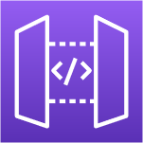
Amazon API Gateway
Amazon API Gateway is a fully managed service that makes it easy for developers to create, publish, maintain, monitor, and secure APIs at any scale.
We use it to expose the following endpoints:
/getDataForSensor
/localSearch
/fixSensor
/subscribeSensor

Slide 14


API Endpoints
/getDataForSensor
/localSearch
It’s used to retrieve the latest state for every sensor that is deployed in the infrastracture
It enables to retrieve the latest data of a list of sensors
/subscribeSensor
/fixSensor
It allow to add a sensor to the infrastracture
It can be used to reset the error state of a sensor that had an issue

Slide 15

AWS Lambda
AWS Lambda is a compute service that lets you run code without provisioning or managing servers.
AWS Lambda is a flexible solution feasible for our serverless approach giving that we don’t have to think about the administration of:
Servers
Operating Systems
Scaling
Logging

Slide 16

Amazon Simple Queue Service
Amazon Simple Queue Service (Amazon SQS) is a fully managed message queuing service that makes it easy to decouple and scale microservices, distributed systems, and serverless applications.
It lets you send, store, and receive messages between software components at any volume, without losing messages or requiring other services to be available.

Slide 17

Amazon Simple Notification Service
Amazon Simple Notification Service (Amazon SNS) is a web service that enables applications, end-users, and devices to instantly send and receive notifications from the cloud.
It allows to deliver Application-to-Application or Application-to-Person notification.
We use it to trigger a lambda function and send an email when a sensor have an issue.

Slide 18
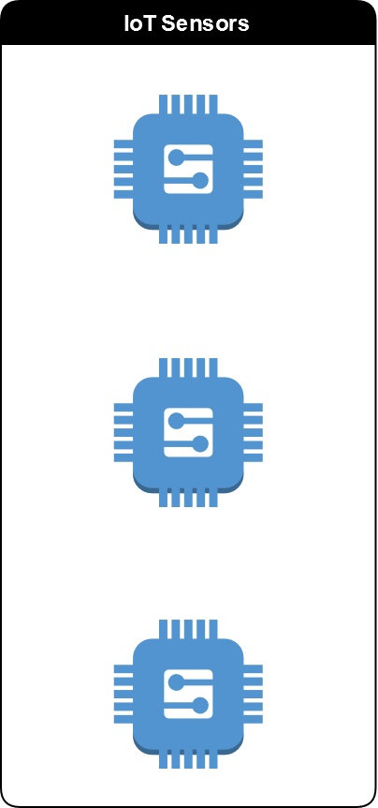
IoT Sensors
The project contains a python script factory.py that allows to simulate a pool of sensors.
The sensors post a message on the SQS Queue when their values are updated.
They post a message on the SNS Topic when an error occurs.
It’s possible to fix a sensor whenever it brokes.

Slide 19

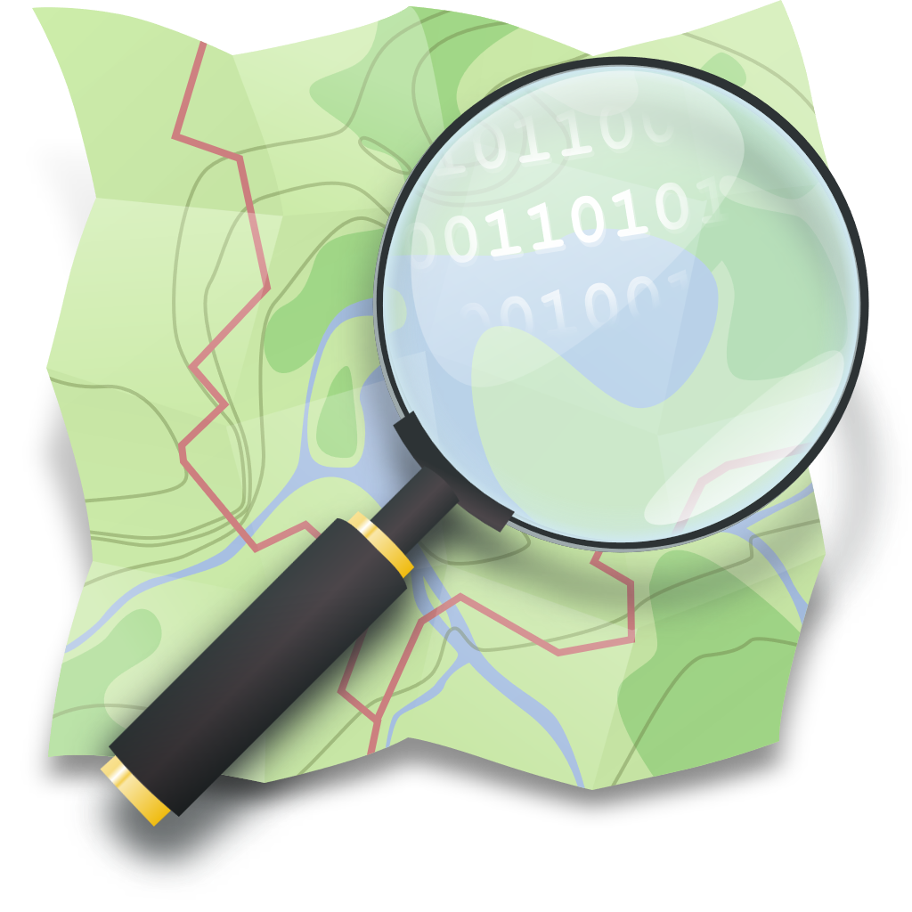
Web App
For this project it’s been created a web application developed using Next.js and OpenStreetMap.
Next.js is an open-source web development framework providing React-based web applications.
OpenStreetMap is a free, open geographic database updated and maintained by a community of volunteers via open collaboration.

Slide 20
Web App Execution flow
The user can get updated data about wind by pressing the refresh button on the top-right of the web app.
Doing so the web app calls the /getDataForSensor API endpoint and shows the results on the map.
For every sensor that is on the map, the user can open the sensor tab that shows the latest results.

Slide 21
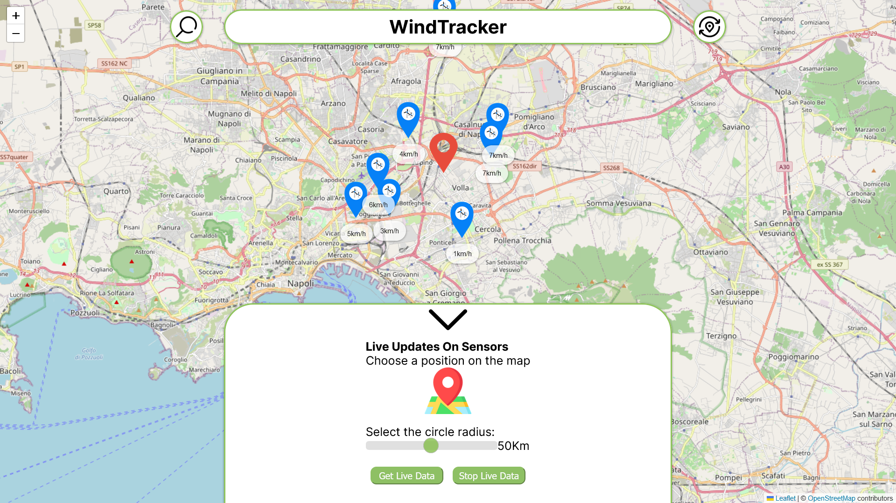
Web App Execution flow
By pressing the button on the top-left of the web app, the user can get live data about wind in a restricted area.
After selecting a point on the map and the radius of the area, the user can click on get live data button.
The web app calls the /localSearch API endpoint and starts getting the updated data about the sensors.

Slide 22
04
Conclusions

Slide 23
Conclusions
The Serverless approach for the infrastructure gives us benefits like:
Minimizing time to market
Reduce costs
Next steps
Some further next steps are:
Implementing data analytics
Implementing routing algorithms for drone delivery

Slide 24

Thanks!
Do you have any questions?

